Slide 1
Ultrasonic Sonar: Radar
SDMay24-24
Client/Advisor: Jiming Song
Members: Jacob Elliott, Julia Falat,
Joseph Hansen, Logan Kinch,
Viola Newman, Chris Penne

Slide 2
Team Contribution
Jacob Elliott (EE): Hardware lead, component researcher, design work, requirements​
Julia Falat (CPRE): Organization, document editor, project planning​
Joey Hansen (EE): Parts sourcing, documentation, PCB Designer
Logan Kinch (SE): Software lead, website maintenance, UI and microcontroller research​
Viola Newman (EE): Client interaction, design work, weekly reports, meeting records​
Chris Penne (EE): Project timeline, design work, part sourcing, project requirements​

Slide 3
Project Overview
Design a device that uses ultrasonic radar to detect objects up to a meter
Will be stationary and will have no moving parts
Cheaper way of detecting objects
Can be implemented in many ways
Notes:
Julia

Slide 4
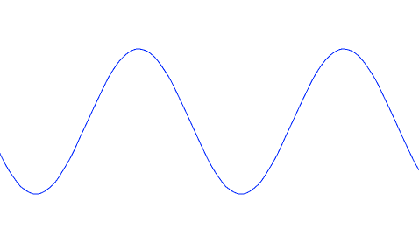
Conceptual Design
Object
Computer (GUI)
w/User Phase Input
Transducers
Receiver
Receiver
Microcontroller (MCU)
Filters
Transducers (10)
Notes:
JOey

Slide 5
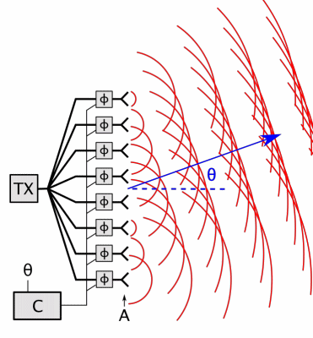
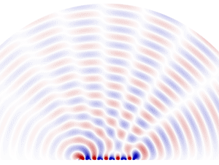
Conceptual Design
Phased Array Implementation​
Notes:
Logan

Slide 6
Final Design
MCU
Phase Shift
40 kHz Pulse
Transducers
Object
Phase Input
GUI
Filters
Receiver
Notes:
Viola

Slide 7
Demonstration
Notes:
Distance
Viola

Slide 8
Demonstration
Notes:
Two objects
Viola

Slide 9
Demonstration
Notes:
Two objects moving
Viola

Slide 10
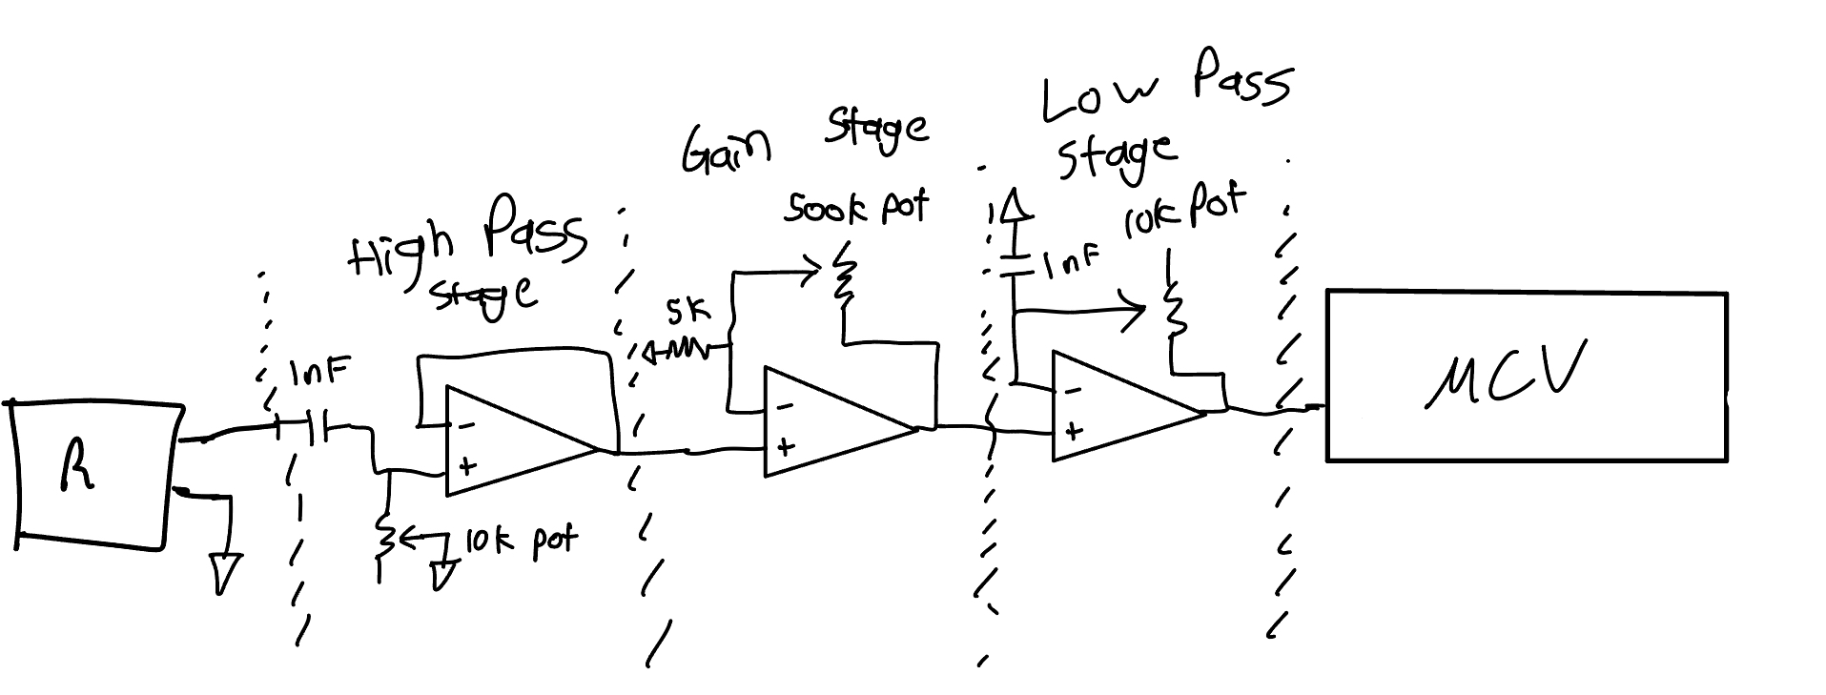
Detail Design (HW)
Transmitting Circuit
+/- 12 VDD and VSS
40 kHz square wave from MCU
100 mV to 3.3 V input to MCU from receiver
10 op-amps to drive each transmitter
Receiving Circuit
Notes:
Jacob Elliott

Slide 11
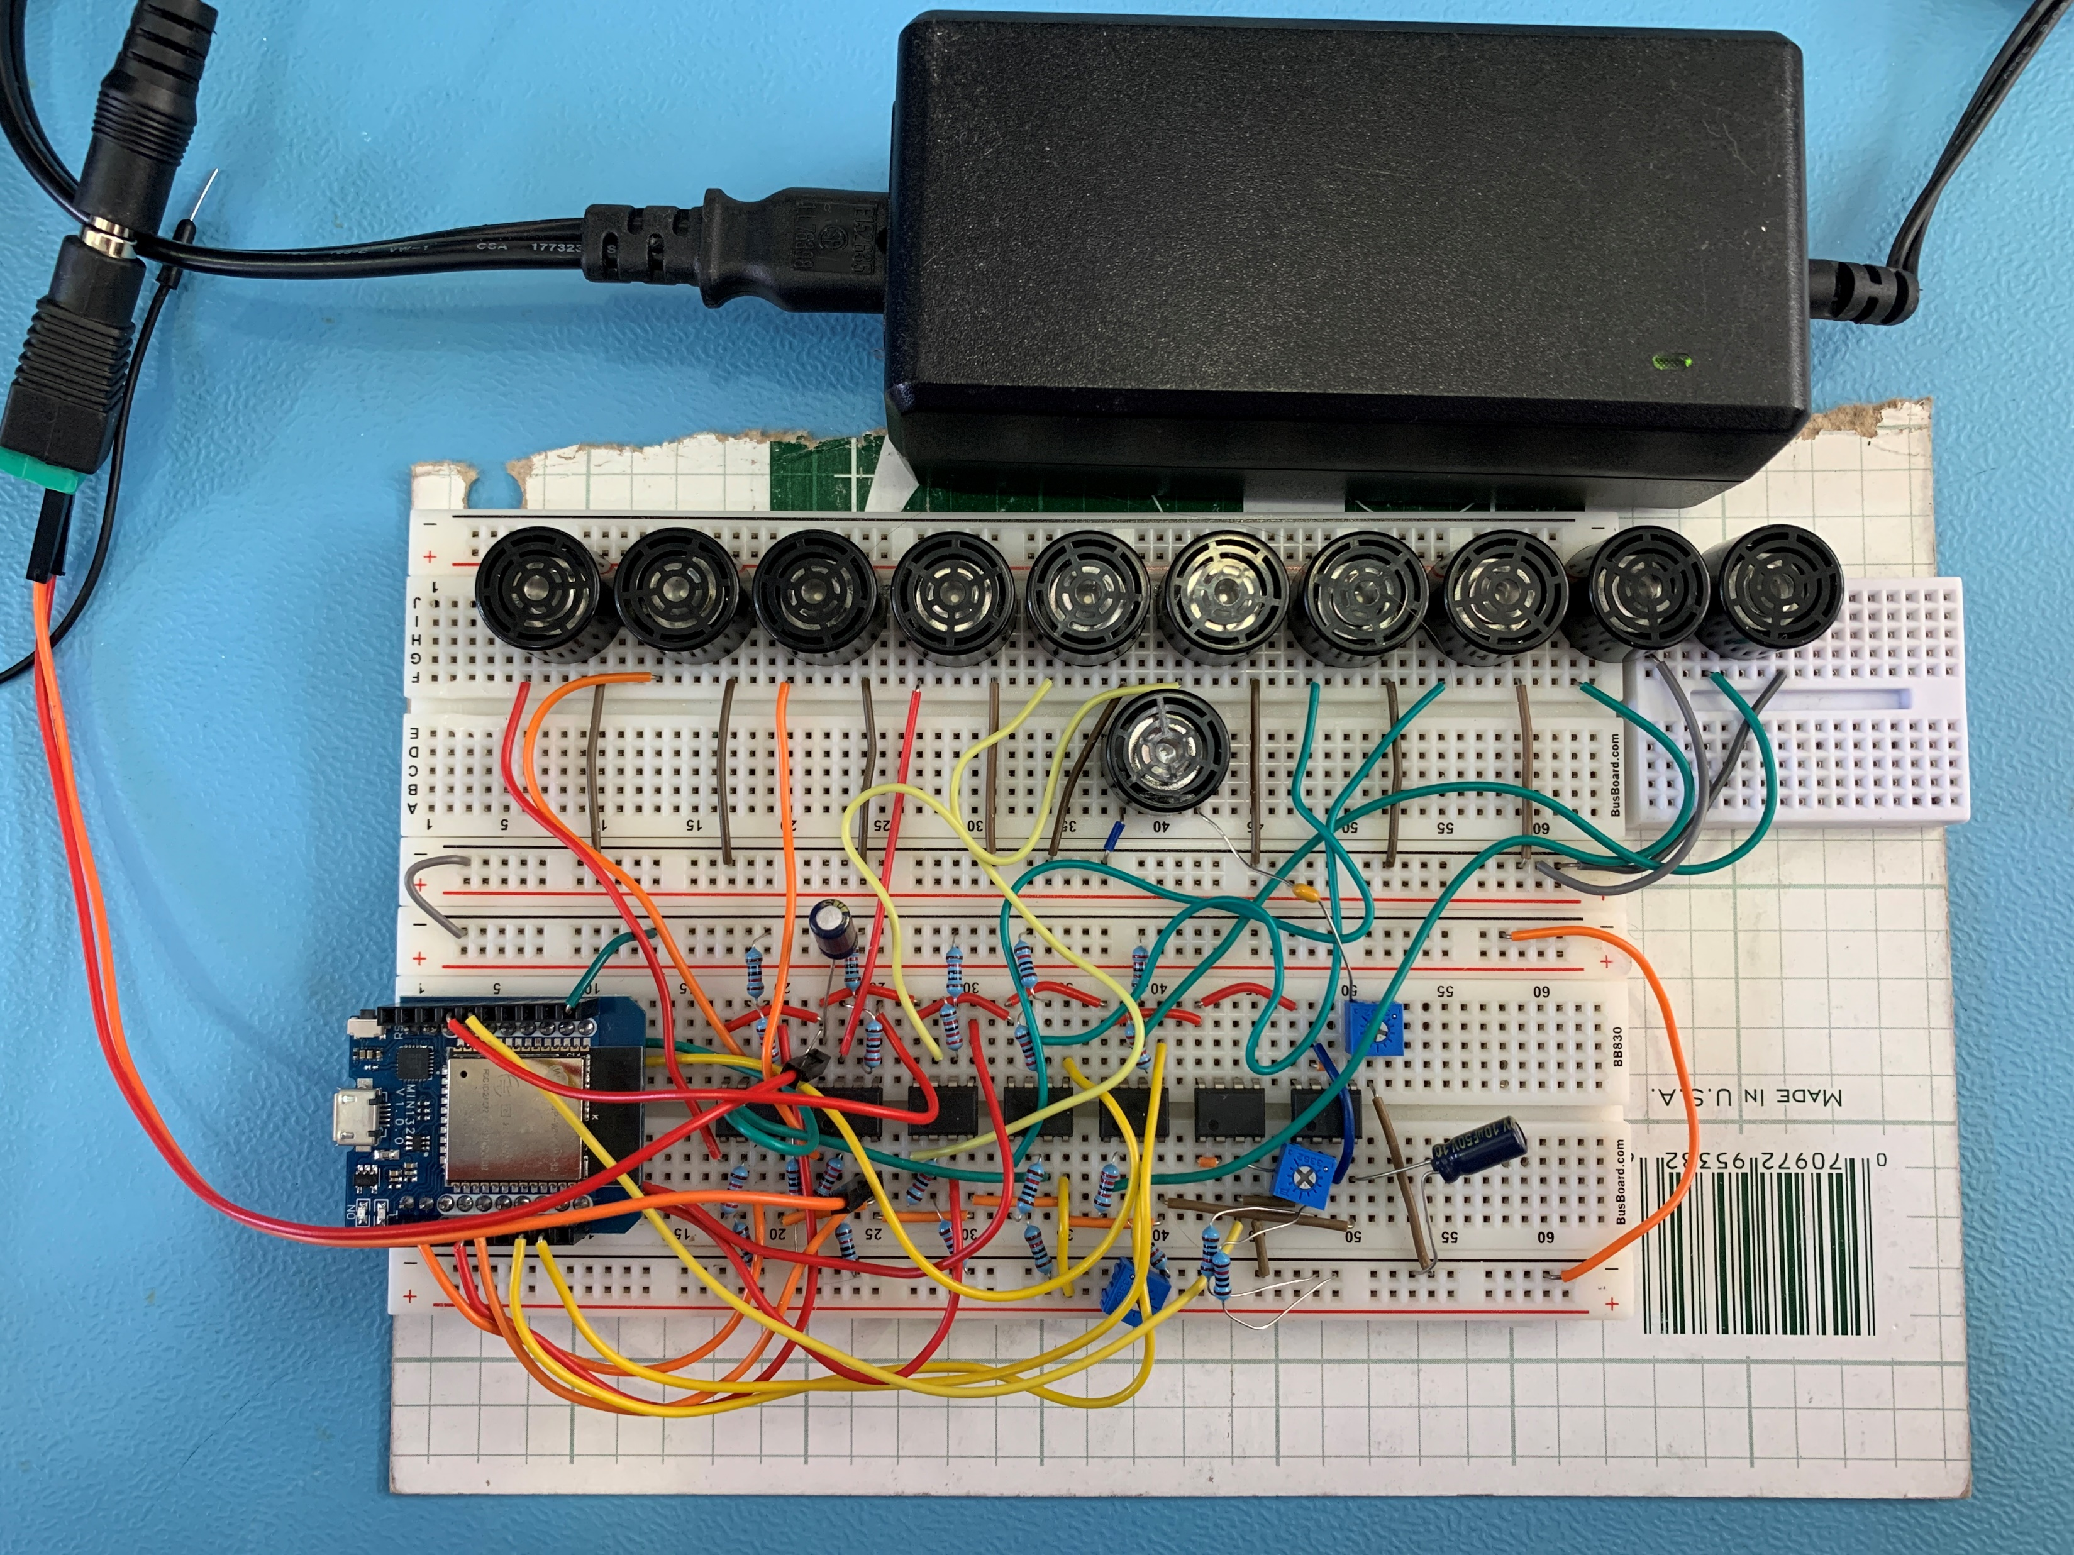
Parts
Power Supply
Transducers
Receiver
Filters
Signal Inputs
Microcontroller
Notes:
Would you want to do this one Jacob? It just shows what each part is.

Slide 12
PCB Design
Notes:
Joey

Slide 13
Detailed Design (SW)
Microcontroller Programming
Arduino IDE
Square wave pulses
Time sent and received calculations
Send data to HTML page
Display Programming
HTML Script
Show objects being detected
Fixed width of area of scanning
JavaScript
Within the HTML script
Renders the data received onto a canvas
Notes:
Logan

Slide 14
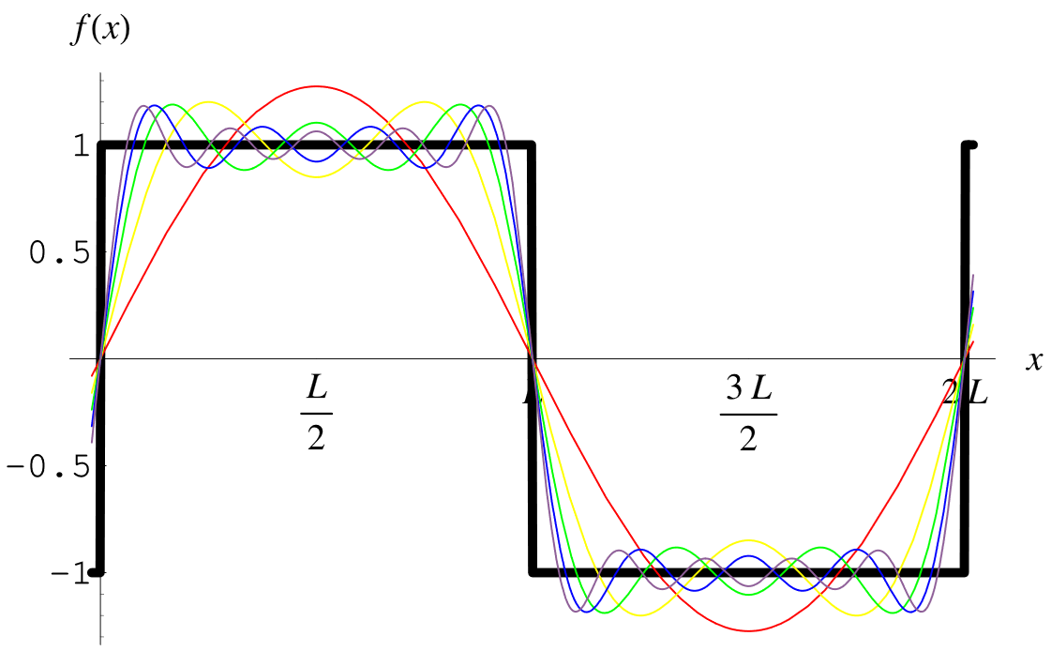
Challenges and Solutions
MCU that we ordered got fried, so we're using personal MCUs to continue working on the project
Op-amp we were originally using had too small of a GBWP for a 40 kHz square wave
Notes:
Chris

Slide 15
Future Students
Current Design
Future Improvements
Ultrasonic Radar can detect both stationary and moving objects up to 1 meter away
Ultrasonic Radar is a cost-effect option for experimenting with phased array implementations of object detection
Print PCB
Increase reading accuracy and distance
More intuitive display of data

Slide 16
Questions

